Slide 1
PLASMONICS Merging photonics and electronics At nanoscale / low dimension
戴极(C), 陈少闻, 吴蒙, 杨婧, 赵怡程, 黄建平, 潘瑞, 陈光缇

Slide 2
Outline
Photonics + Electronics @ nanoscale
Plasmonic Chips
Plasmonic Nano-lithography
Plasmonic Light Sources
Improved Photovoltaic Devices
Graphene Plasmonics
Main References:
Ekmel Ozbay. Science 311, 189 (2006);

Slide 3
Revival of Plasmoncis
Conventional Electronic Circuits :
Transport and storage of electrons
Interconnect scaling → RC delay increases
Conventional Photonic Circuits :
>1000 times capacity of electronic interconnects
Optical diffraction → 1000 times larger → compatibility problem
Electronic + Photonic circuits → Plasmonic Chips
Notes:
Plasmon的理论在好几十年前就提出了，然而近些年又在实验中获得广泛关注。一方面是直到最近科学家才能制备高质量可控的纳米结构，另一方面也是传统electronics,有其interconnect逐渐遇到瓶颈，传统基于bulk的photonics又不利于和electronics兼容。
传统电子电路操控电子，随着电路scaling，互连的RC延迟变得显著，使得时钟频率难以提高
传统光子学的线路虽然传输速度快，但是光纤体积巨大，难以和电路兼容
所以想到结合两者，即用plasmon来完成scaling+speed

Slide 4
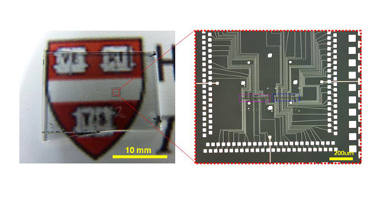
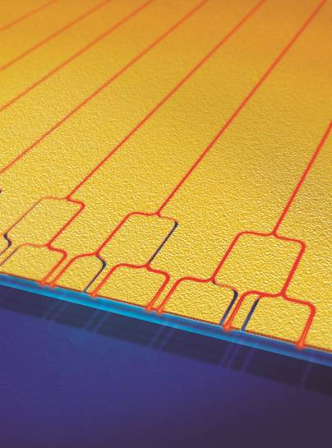
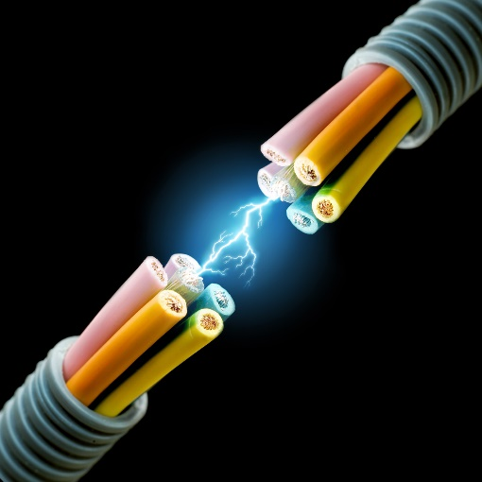
Plasmonic Chips
+
=
Two integrated programmable nanowire (~10nm in diameters) logic circuit tiles on a glass substrate. From the image gallery of Charles Lieber research group.
Optic fiber
Yulan Fu, et al, All-optical logic gates based on nanoscale plasmonic slot waveguides, Nano Lett. 2012, 12, 5784−5790.
Surface Plasmonic circuits
Circuit with nanoscale features that can carry optical signals & electrical currents.
Even logic operations can be made.
Notes:
Plasmonic curcuits offer the potential to carry optical signals and electric currents through the same thin metal circuitry, thereby creating the ability to combine the superior technical advantages of photonics and electronics on the same chip

Slide 5
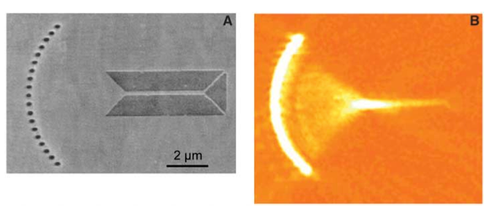
Plasmonic Couplers
Plasmonic couplers:
Light → Plasmon
W. Nomura, M. Ohtsu, T. Yatsui, Appl. Phys. Lett. 86, 181108 (2005).
Notes:
Surface plasmons are bound to the metallic surface with exponentially decaying fields in both neighboring media. The decay length is on the order of 10nm, which provides the possibility of localization and the guiding of light in subwavelength metallic structures.
a 250-nm-wide Ag strip guide
a quarter circle with a 5-μm radius
the transmission length through the coupler is 4.0 μm
focused SPs propagate along the guide, where they partially penetrate into the 100-nm-wide bifurcation at the end, thus overcoming the diffraction limit of conventional optics

Slide 6
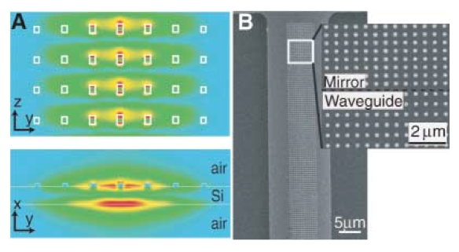
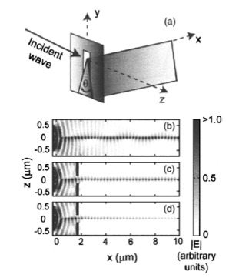
Subwavelength Localization
Nanowire – ohmic losses
Nano Array
~50 um
S. A. Maier, et al, Appl. Phys. Lett. 86, 071103 (2005).
D. Pile, et al. Appl. Phys. Lett, 87, 061106 (2005).
Notes:
(A)Propagates in the z direction
waveguide structure is not uniform across its width where the size of the metal dots is reduced from 80 to 50nm at the edges. This has the effect of confining the energy more intently to the middle of the guide @ 1500 nm wavelength
(B)
R-
The major features of plasmons in V grooves include a combination of strong localization, single-mode operation, the possibility of nearly 100% transmission through sharp bends, and a high tolerance to structural imperfections.
Trade-off between propagation length and mode size(confinement).

Slide 7
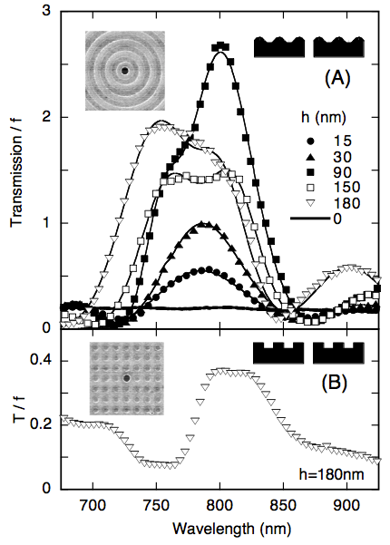
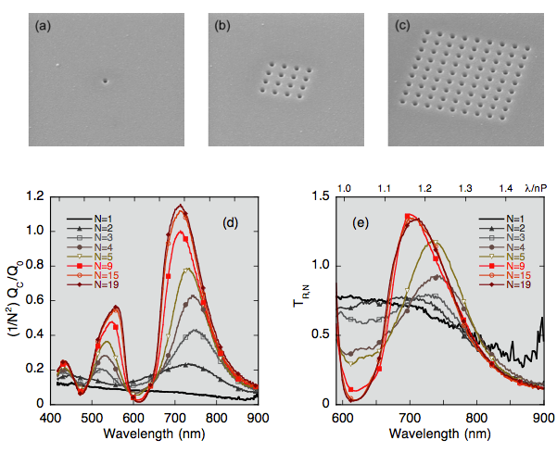
Transmission Enhancement
Debatable theoretically
L: H. J. Lezec, et al. Opt. Exp. 12, 3629 (2004).
R: T. Thio, et al. Opt. Lett. 26, 1972–1974 (2001).
Notes:
as-collected transmission spectra for selected N; (e) corresponding per-hole transmission coefficient TR,N(λ) for selected N.
The optical transmission of a subwavelength aperture in a metal film is enhanced when it is placed in a periodic array, or when it is surrounded by a periodic corrugation on its illuminated surface.

Slide 8
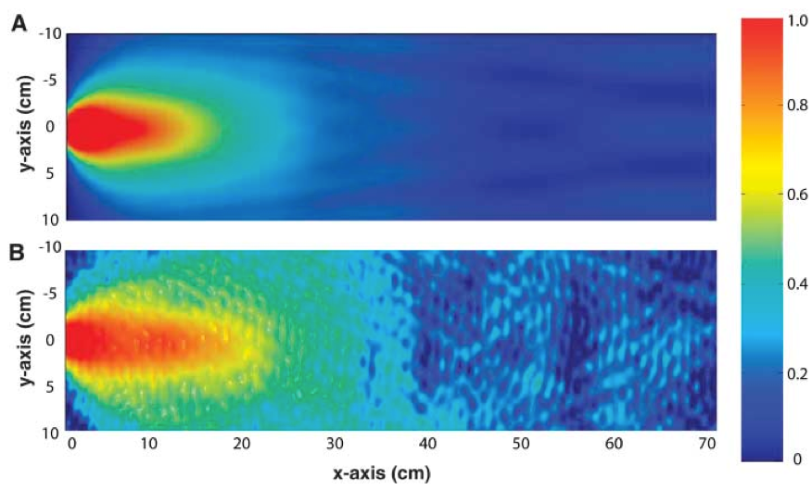
Angular confinement of transmitted light
Simulation
Experiment
Notes:
in which the angular divergence of the beam is +- 3 degree

Slide 9
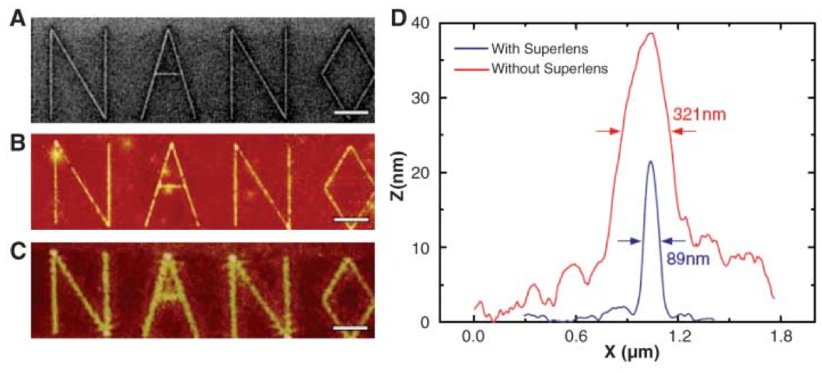
Plasmonic Nanolithography – “Superlens”
Made with material of negative ε or μ, or both.
FIB
Superlens
~ 4 times
promotion
Traditional
J. B. Pendry, Phys. Rev. Lett. 85, 3966 (2000). > 7000 citations
Notes:
If we can have negative index materials~
The exact physics is not quite understood

Slide 10
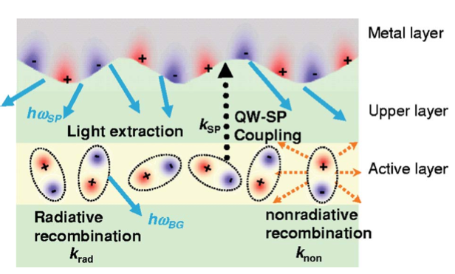
Plasmon Enhanced Light Sources
Traditional LED – low light-emission efficiencies
InGaN/GaN Quantum Well(QW) coated by ~nm silver
32-fold emission rate increase
K. Okamoto et al., Appl. Phys. Lett. 87, 071102, (2005).
Notes:
recombination rates, k_rad & k_non. and when the bandgap energy of InGaN active layer is close to the electron vibration energy of SP at the metal-semiconductor surface, then the QW energy can transfer to the SP.
This enhancement of the emission rates and intensities results from the efficient energy transfer from electron-hole pair recombination in the QW to electron vibrations of SPs at the metal-coated surface of the semi- conductor heterostructure. This QW-SP coupling is expected to lead to a new class of super bright and high-speed LEDs that offer realistic alternatives to conventional fluorescent tubes.

Slide 11
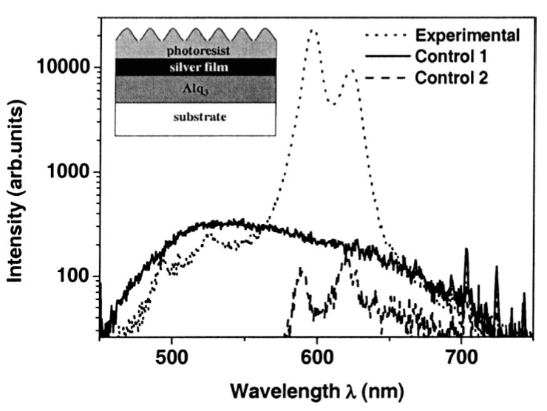
Plasmon Enhanced Light Sources
OLED light emitting enhanced
S. Wedge, et al. Appl. Phys. Lett.
85, 182 (2004).
Notes:
The addition of a nanopatterned dielectric overlayer to the cathode of top-emitting OLEDs should increase light emission from these structures by two order of magnitude over a similar planar structure. The dielectric layer acts to couple the surface plasmon-polariton modes on the two metal surfaces, whereas its corrugated morphology allows the modes to scatter to light.

Slide 12
Outline
Photonics + Electronics @ nanoscale
Improved Photovoltaic Devices
Background
With Localized SP or SP Polaritons
Graphene Plasmonics
Main References:
H.A. Atwater, A. Polman. Nat. Mat. 9, 205 (2010);

Slide 13
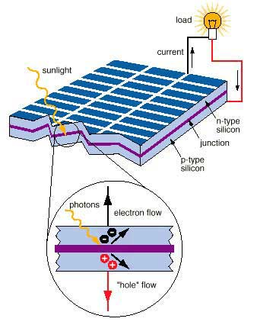
Background
Convert sunlight to electricity
Traditionally
long absorption length →
large film thickness →
large cost
http://www.wbdg.org/resources/photovoltaics.php
Notes:
这是其中最传统的一种，还有染料敏化杂化电池，量子点电池，有机电池

Slide 14
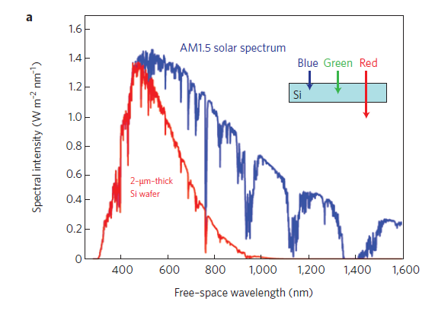
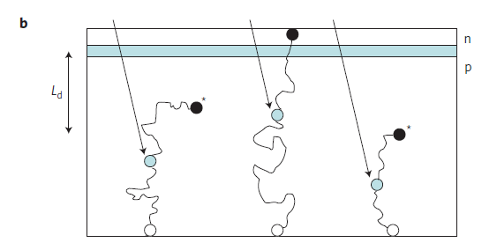
Background
Solar energy absorbed in a 2-μm-thick crystalline Si film, spectral range 600-1000nm is poorly absorbed.
Charge carriers generated far away are not effectively collected, owing to bulk recombination. → trade-off!

Slide 15
Plasmonics for Enhanced Photovoltaics
Plasmonic Light-trapping Geometries
(a) Metallic nanoparticles as scattering element, folding light into a thin absorber layer
(b) Metallic nanoparticles as antennas, increasing effective absorption cross-section
(c) Corrugated metallic film couple sunlight into SPP modes and guide modes in the semiconductor slab
Notes:
Lower material costs
Increase open-circuit voltage
Reduce carrier recombination – allowing for the use of materials with low diffusion lengths (polycrystalline semiconductors, quantum-dot layers, organic semiconductors)

Slide 16
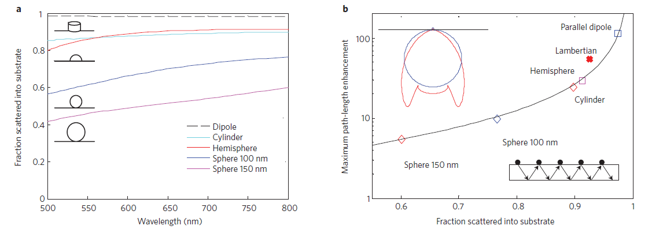
Light Scattering Using Particle Plasmons
(Left) When nanoparticle is placed close to the interface between two dielectrics, light will scatter preferentially into the dielectric with the larger permittivity ε, thus increase the optical path length.
(Down) Shape and size of the nanoparticle are key factors determining efficiency.
Notes:
Lower material costs
Increase open-circuit voltage
Reduce carrier recombination – allowing for the use of materials with low diffusion lengths (polycrystalline semiconductors, quantum-dot layers, organic semiconductors)
The exact mechanisms are still open to debate as of 2010.
Smaller structures can couple light better.

Slide 17
Light Concentration Using Particle Plasmons
The nanoparticle stores the incident energy in a localized surface plamon mode, increasing the absorption rate, particularly in the junction area.
For previous page
Notes:
Down left: for previous page, broader scattering rage when particles are embedded in Si or Si-N-composite//
Useful for short carrier diffusion lengths (he absorption rate in the semiconductor must be larger than the reciprocal of the typical plasmon decay time)

Slide 18
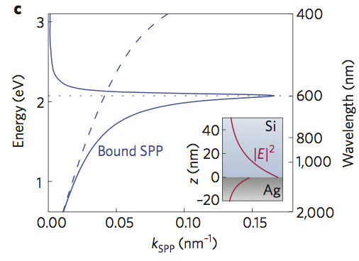
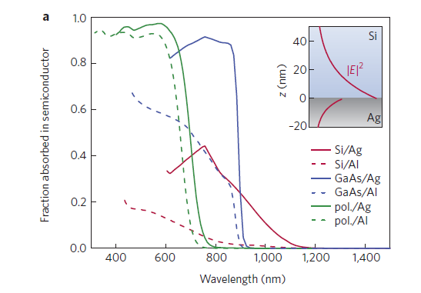
Light Trapping Using SPP
Light is converted into SPPs, travelling along the interface. Solar flux is effectively turned by 90º.
Notes:
Lower material costs
Increase open-circuit voltage
Reduce carrier recombination – allowing for the use of materials with low diffusion lengths (polycrystalline semiconductors, quantum-dot layers, organic semiconductors)

Slide 19
Outline
Photonics + Electronics @ nanoscale
Improved Photovoltaic Devices
Graphene Plasmonics
Intrinsic graphene plasmons
Graphene-based plasmonic hybrid devices
Main References:
A. N. Grigorenko, et al. Nat. Phon. 6, 749 (2012).

Slide 20
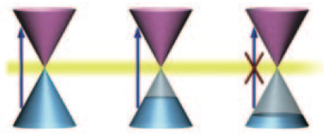
Pauli Blocking in Graphene
Pauli Blocking → E_{photon} > 2 E_{F}
Achieved E_{F} ~ 1 eV → visible spectrum

Slide 21
Intrinsic Graphene Plasmons
TM and TE modes are both available in graphene
TE modes allow frequency slightly smaller than Pauli-blocking threshold:
Comes along with Dirac spectrum of electrons
“The new mode propagates along the graphene layer with the velocity close to the velocity of light, has a weak damping, and its frequency is tunable across a broad frequency range from radio waves to the infrared. ”
-- Mikhailov, S. A. & Ziegler, K. Phys. Rev. Lett. 99, 016803 (2007).

Slide 22
Massless Dirac Fermion (MDF)
In graphene
Kinetic + e-e Interaction
Graphene fine-structure constant
~ 2.2 for suspended sheet
electrons in graphene interact quite strongly
MDF =/= 2D electron gas
Notes:
Vf=10 6
1+2/

Slide 23
2D plasmons

Slide 24
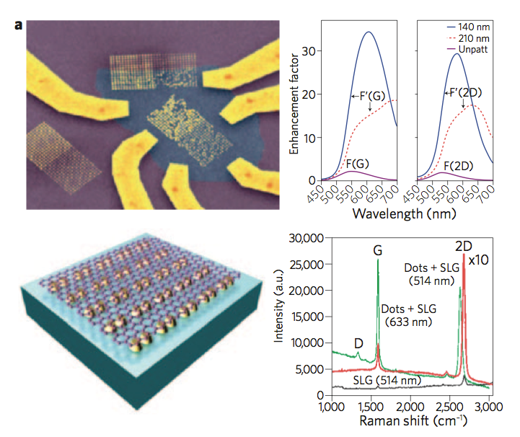
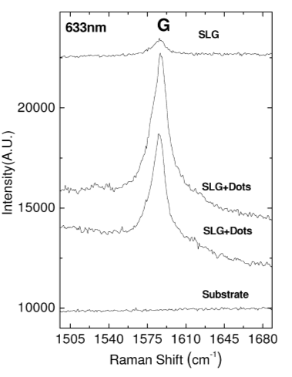
Graphene based plasmon App 1
Enhance Raman scattering for graphene
Notes:
Because interaction of light with graphene is determined by the local electromagnetic fields (induced on the graphene sheet), this interaction can effectively be increased by placing metal nanostructures close to the graphene.
First row: lamda = 633 nm

Slide 25
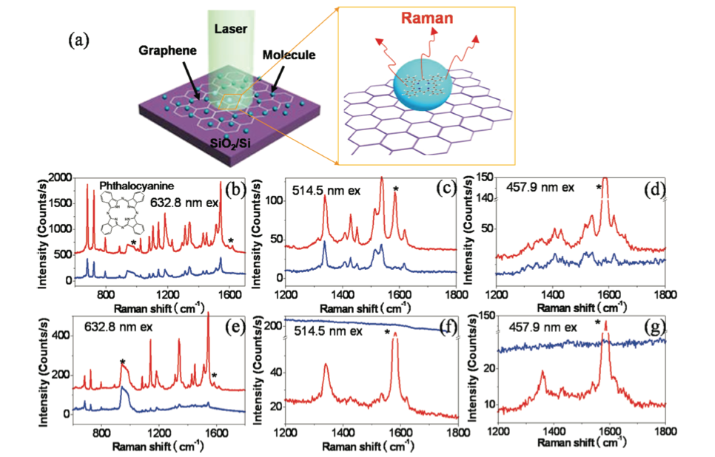
App 1.1 – Graphene for Surface Enhanced Raman Spectroscopy
Notes:
2D atomic smooth surface, known Raman spectroscopy,
EM picture vs. CM picture for SERS

Slide 26
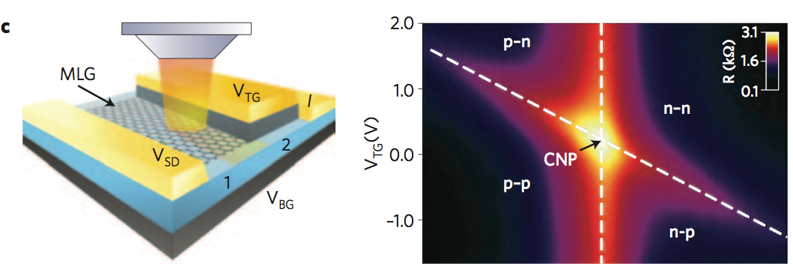
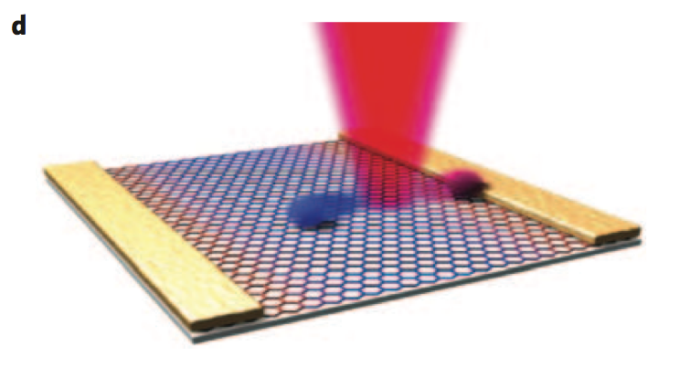
App2 – photovoltage enhancement
V_{BG} (V)
Notes:
Enhanced electrical field
Nonlocal hot electrons seperated by metallic contacts built-in electric field

Slide 27
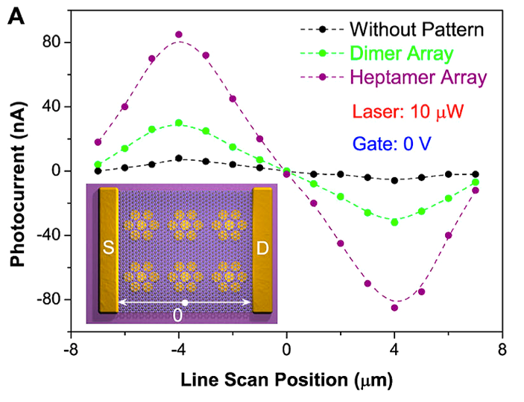
A little more for
your knowledge…
Fang, Zheyu, et al. Graphene-Antenna Sandwich Photodetector, Nano Lett. 2012, 12, 3808
Notes:
Both field enhancement and hot electron effect

Slide 28
Graphene-based plasmonic hybrid devices
Hot topic, but still challenging!
2D building blocks (graphene, hBN, TMDCs, etc.)
Semimetal, dielectrics, semiconductors …
Ultra-fast optical modulators, graphene-based 2D laser
Strong confinement & interaction
Tunable?
More to be discovered.

Slide 29
Thank you!
戴极(C), 陈少闻, 吴蒙, 杨婧, 陈志超, 黄建平, 潘瑞, 陈光缇

